Slide 1

Academic Writing
Task 1

Slide 2
IELTS WRITING LESSON 3
静态图特征
表示“占比”基本句型
做比较的基本句型
单饼描述练习
静态图审题和分段
真题演练

Slide 3
IELTS WRITING LESSON 3
静态图特征
表示“占比”基本句型
做比较的基本句型
单饼描述练习
静态图审题和分段
真题演练

Slide 4
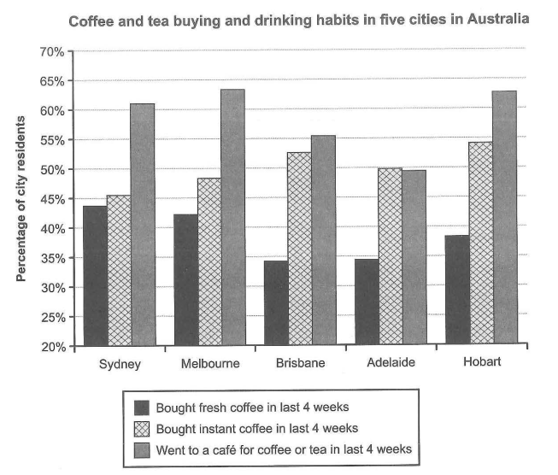
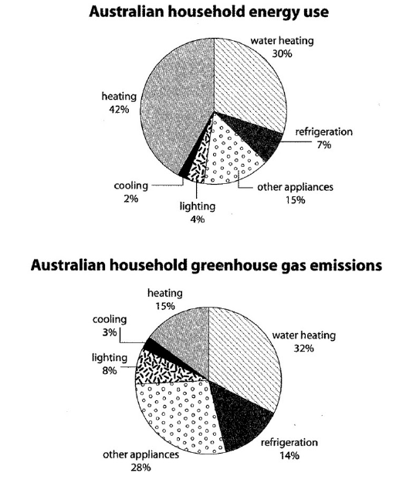
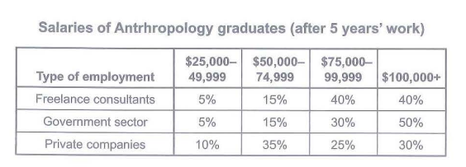
Task 1 静态图
无时间变化：无趋势 => 静态图
描述整体构成
描述和比较每部分数值/占比
(C15T1W1)
(C10T1W1)
(C15T4W1 fig.1)

Slide 5
IELTS WRITING LESSON 3
静态图特征
表示“占比”基本句型
做比较的基本句型
单饼描述练习
静态图审题和分段
真题演练

Slide 6
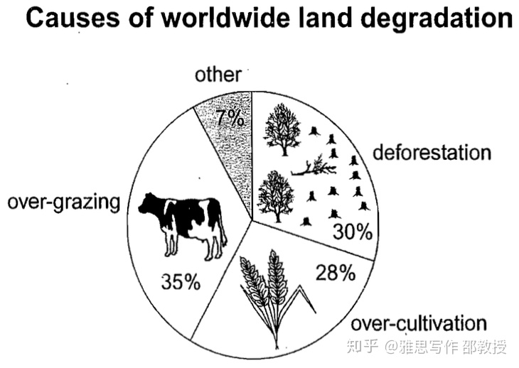
Task 1 “占比”
描述对象
占/构成
比例
of 整体
时间 (有的静态图没有时间信息)
(C8T1W1 fig.1)

Slide 7
Task 1 “占比”
 | account for 占x%的...
 | make up 构成x%的...
 | constitute 构成x%的...
 | comprise 构成x%的...
描述对象
X %
of ___(总体)

Slide 8
Task 1 “占比”
句型
由过度放牧导致的土壤退化占全世界土壤退化的35%。
Over-grazing accounts for 35% of worldwide land degradation.
35% of worldwide land degradation is caused by over-grazing.
The percentage of land degradation caused by over-grazing is 35%.
(C8T1W1 fig.1)

Slide 9
Task 1 “占比”
X % => 分数
35% of worldwide land degradation is caused by over-grazing.
35% ≈ 33% => 1/3
分子 = 基数词；分母 = 序数词
1/3 => a/one third
2/3 => two thirds
3/4 => three fourths/quarters
1/5 => one fifth
*1/2 => half

Slide 10
Task 1 “占比” 练习
Practice
Percentage of national consumer expenditure (2002)
In Turkey, food/drinks/tobacco accounted for nearly one third of national consumer expenditure.
The proportion of consumer expenditure on food /drinks/ tobacco in Turkish was 32.14%.
About one third of consumer expenditure was spent on food/drinks/tobacco in Turkey.
Country | Food/Drinks/Tobacco
Ireland | 28.91%
Italy | 16.36%
Spain | 18.80%
Sweden | 15.77%
Turkey | 32.14%
(C7T1W1 col.1)

Slide 11
IELTS WRITING LESSON 3
静态图特征
表示“占比”基本句型
做比较的基本句型
单饼描述练习
静态图审题和分段
真题演练

Slide 12
Task 1 “比较”
如何比较数值
极值 (最大/最小)
比较级 (比…多/比…少)
相等/相似
倍数

Slide 13
Task 1 “比较”
由过度放牧导致的土壤退化占全世界土壤退化的35%。
Over-grazing accounts for the highest percentage of worldwide land degradation, with 35%.
the highest percentage of worldwide land degradation is caused by over-grazing, at 35%.
The percentage of land degradation caused by over-grazing is the highest, at 35%.
极值（最大/最小）
(C8T1W1 fig.1)

Slide 14
Task 1 “比较”
最大
the highest percentage
the highest proportion
the largest part
the majority
最小
the lowest percentage
the lowest proportion
the smallest part
the minority

Slide 15
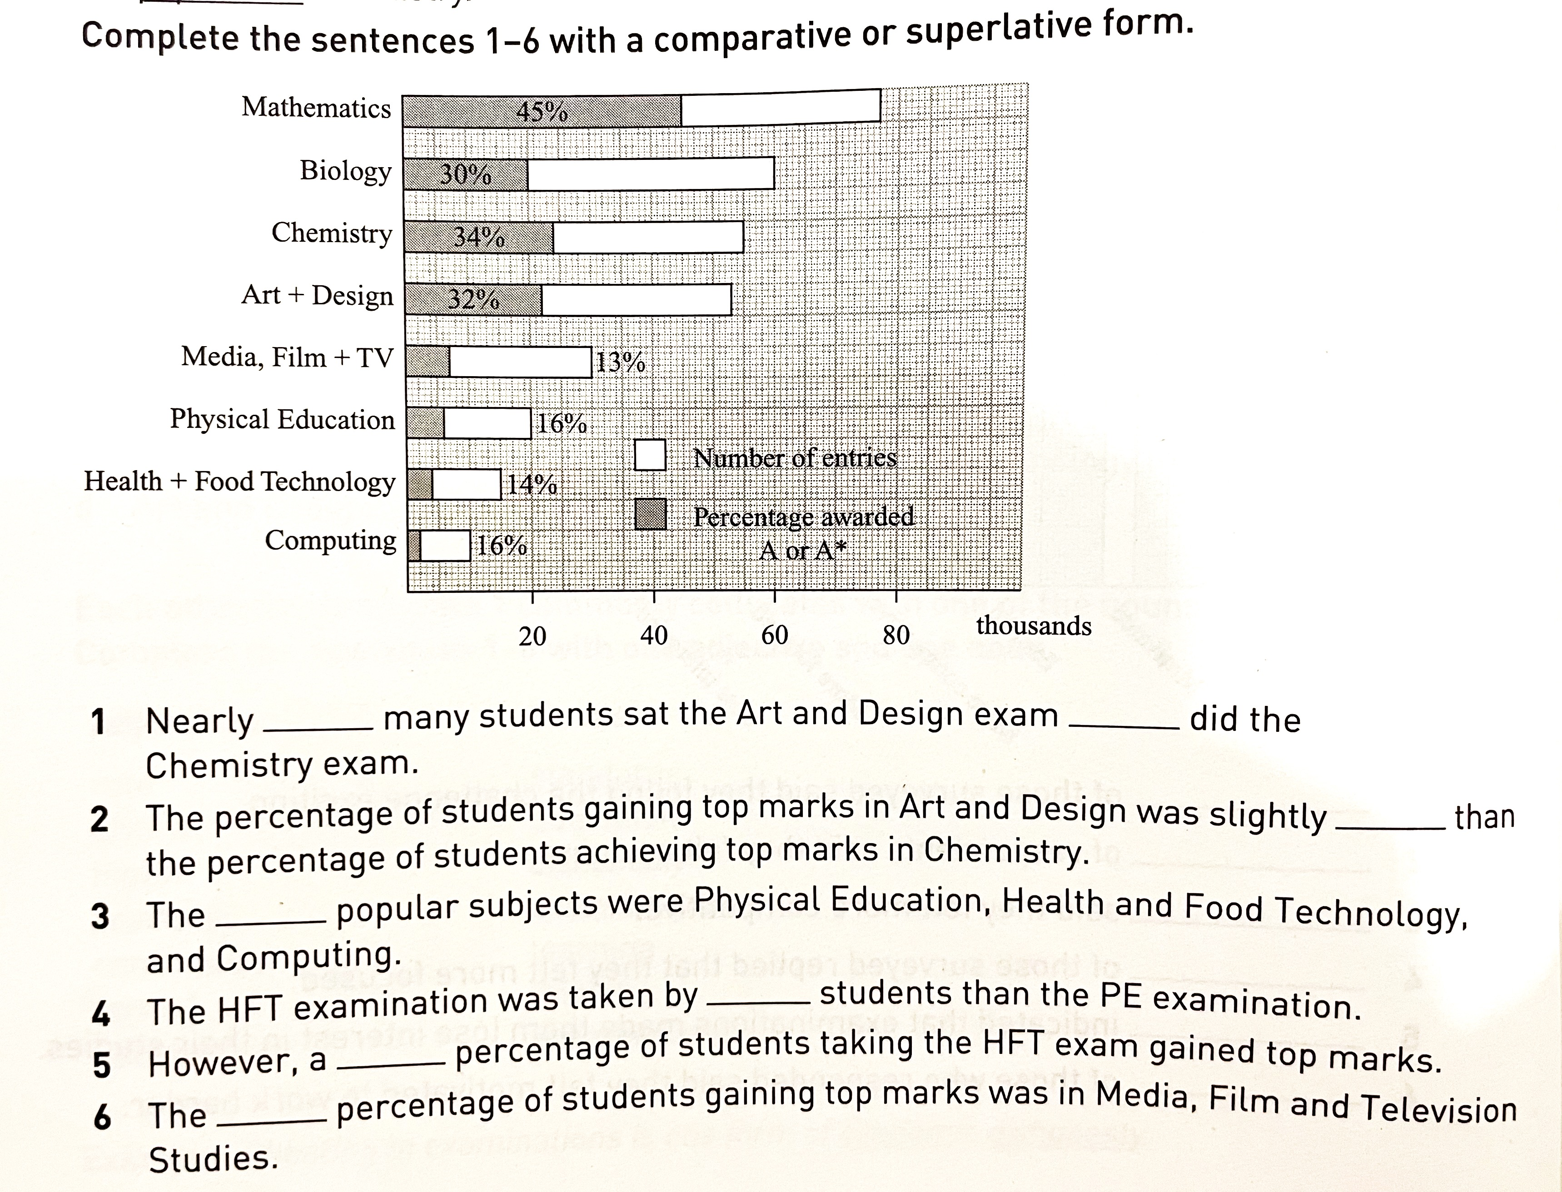
Practice:
《胡敏雅思教材第7代》P26 第1题
as
as
lower
least
fewer
higher
lowest

Slide 16
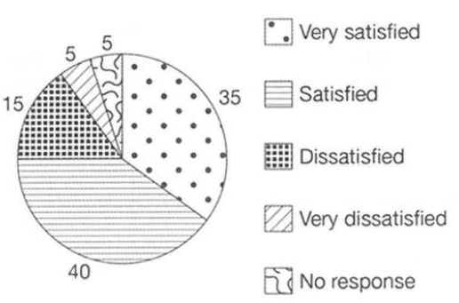
Task 1 “比较”
比较级 (比…多/比…少)
满意的游客的百分比比非常满意的游客的百分比高5%。
The percentage of visitors who were satisfied was 5% higher than that of those who were very satisfied.
Visitors who felt satisfied were 5% more than those who were very satisfied.
比较对象要有可比性 (保持一致)
(C11T4W1 fig.3)
Results of surveys of visitor satisfaction

Slide 17
Task 1 “比较”
比较级 (比…多/比…少)
满意的游客占40%，比非常满意的游客的百分比高5%。
Visitors who felt satisfied accounted for 40%, who were 5% more than those who were very satisfied.
Visitors who felt satisfied accounted for 40%, 5% more than those who were very satisfied.
(C11T4W1 fig.3)
Results of surveys of visitor satisfaction

Slide 18
Task 1 “比较”
相等/相似
非常不满的游客的百分比与无反馈的游客的百分比一致，均为5%。
The percentage of visitors feeling very dissatisfied was equal to that of those giving no response, at 5%.
be equal to = be (roughly) the same as
Visitors feeling very dissatisfied and giving no response shared the same proportion, with 5%.
share the same (similar) proportion/ amount
Results of surveys of visitor satisfaction

Slide 19
Task 1 “比较”
倍数
三倍 three times/ triple
对象1 be three times/triple 对象2
(C11T4W1 fig.3)
Results of surveys of visitor satisfaction

Slide 20
Task 1 “比较”
倍数
不满意的游客的百分比是非常不满意的游客的百分比的三倍。
The percentage of visitors who felt dissatisfied was three times that of those feeling very dissatisfied.
The percentage of visitors who felt dissatisfied was triple that of those feeling very dissatisfied.
(C11T4W1 fig.3)
Results of surveys of visitor satisfaction

Slide 21
Task 1 “比较”
倍数
二倍 | double | If something is double the amount or size of another thing, it is twice as large. 双倍的
三倍 | triple | If something is triple the amount or size of another thing, it is three times as large. 3倍的
四倍 | quadruple | If one amount is quadruple another amount, it is four times bigger. 4倍的

Slide 22
IELTS WRITING LESSON 3
静态图特征
表示“占比”基本句型
做比较的基本句型
单饼描述练习
静态图审题和分段
真题演练

Slide 23
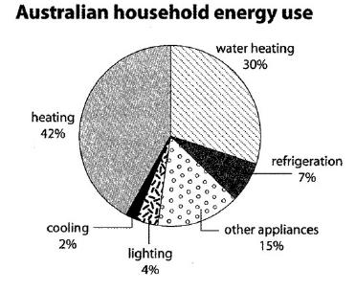
Task 1 单饼描述练习
描述以下数据分布。
4-6句
注意词汇、句型变换
注意项目间的比较
(C10T1W1 fig.1)

Slide 24
Task 1 单饼描述练习
In an Australia household, 42% energy is used on heating, which is the most. The second largest proportion, nearly one third, of energy is consumed by water heating, and it is also double the power used by other appliances. In contrast, energy consumption of refrigeration, lighting and cooling accounts for a smaller part, with 7%, 4% and 2% respectively.
(C10T1W1 fig.1)

Slide 25
IELTS WRITING LESSON 3
静态图特征
表示“占比”基本句型
做比较的基本句型
单饼描述练习
静态图审题和分段
真题演练

Slide 26
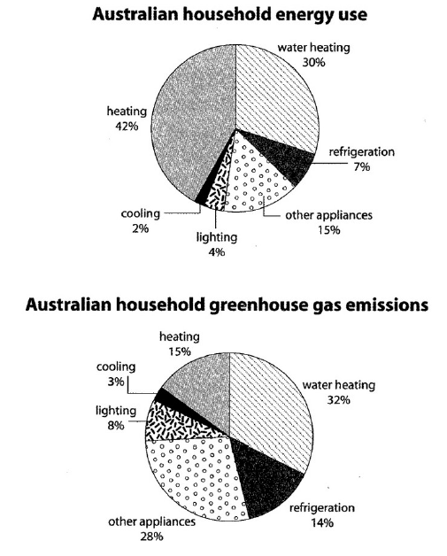
C10T1W1 静态饼图
The first chart below shows how energy is used in an average Australian household. The second chart shows the greenhouse gas emissions which result from this energy use.

Slide 27
C10T1W1 分段思路
思路1：
Body1: energy use
Body2: emissions
思路2：
Body1: heating & water heating
Body2: refrigeration, other, lighting, cooling

Slide 28
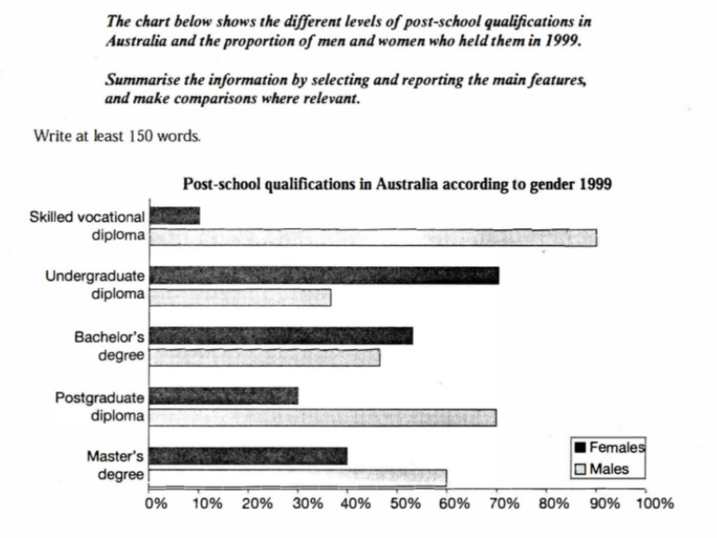
C4T3W1 静态柱图

Slide 29
C4T3W1 分段思路
思路：
Body 1: males > females (skilled vocational diploma, postgraduate diploma and master’s degree)
Body 2: females > males (undergraduate diploma and bachelor’s degree)

Slide 30
C5T4W1 静态表格
The table below gives information about the underground railway systems in six cities.
City | Date opened | Kilometres of route | Passengers per year (in millions)
London | 1863 | 394 | 775
Paris | 1900 | 199 | 1191
Tokyo | 1927 | 155 | 1927
Washington DC | 1976 | 126 | 144
Kyoto | 1981 | 11 | 45
Los Angeles | 2001 | 28 | 50

Slide 31
C5T4W1 分段思路
City | Date opened | Kilometres of route | Passengers per year (in millions)
London | 1863 | 394 | 775
Paris | 1900 | 199 | 1191
Tokyo | 1927 | 155 | 1927
Washington DC | 1976 | 126 | 144
Kyoto | 1981 | 11 | 45
Los Angeles | 2001 | 28 | 50
思路1：
Body1: date opened
Body2: km of route
Body3: passengers per year
思路2：
Body1: date opened & km of route
Body2: passengers per year

Slide 32
IELTS WRITING LESSON 3
静态图特征
表示“占比”基本句型
做比较的基本句型
单饼描述练习
静态图审题和分段
真题演练

Slide 33
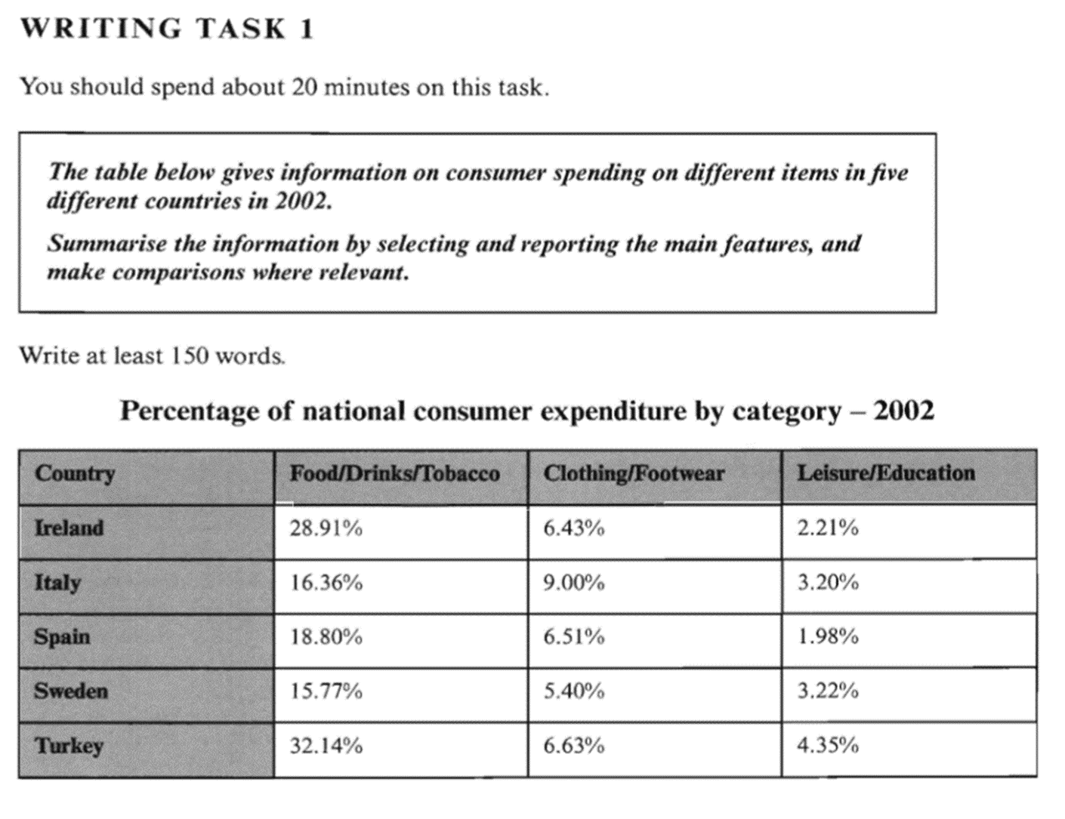
Task 1 静态图 真题演练 (C7T1)

Slide 34
Task 1 静态图 真题演练 (C7T1)
审题：
1. 读题
2. 读图
3. 判断图表类型：动态or静态
4. 确定时态：一般过去时

Slide 35
Task 1 静态图 真题演练 (C7T1)
文章结构：
开头段：改写题目，介绍图表信息
总结段Overview：对比特征
最大组：最多的钱花在food/drinks/tobacco
最小组：最少的钱花在leisure/education
土耳其的支出普遍高于其他四个国家
主体段1：对比最大和最小
主体段2：对比clothing/footwear

Slide 36
Task 1 静态图 考官范文赏析 (C7T1)
The table illustrates the proportion of national expenditure in Ireland, Italy, Spain, Sweden and Turkey on three types of consumer items in 2002.
Overall, the category of consumer goods that all countries spent most on was food, drinks and tobacco, which was three times higher than on the other types of goods. The lowest spending could be seen in the category of leisure and education in all five countries. The outlay of Turkey was generally higher than the other four countries.

Slide 37
Task 1 静态图 考官范文赏析 (C7T1)
In terms of food, drinks and tobacco, Turkey spent the most at 32.14%. The expenditure of Ireland was also high (28.91%) compared to Sweden which spent the least (15.77%). Spain and Italy spent 18.80% and 16.36% respectively. On the other hand, the lowest expenditure was on leisure and education which accounted for under 5% in all countries. Turkey spent most on these items at just 4.35% of their national expenditure which was around double that of Spain (1.98%).
Clothing and footwear was the third category of consumer goods and outlays for those items were between 9% in Italy and 5.40% in Sweden. The national spending in this area for the remaining countries averaged around 6.5%.

Slide 38
Task 1 静态图
Summary
动态图：无时间变化、无趋势
描述比例/数值：“占比”、分数、三种基本句型
比较方式：极值(最大/最小)、比较级(比…多/比…少)、相等/相似、倍数
主体段描述顺序：从大到小
静态图主体段分段：1. 分布 2. 落差 3. 数值大小 4. 项目名称
找出图表中数据规律与关系，勿流水账式挨个照搬
突出重点项目/数据，略写不重要的信息

Slide 39
HOMEWORK
完成一篇完整的小作文
要求：
1.分段描述数据
2.灵活运用不同词汇句型
3.概括信息/分析重点

Slide 40
Practice makes perfect !
Thank you.

